Slide 1
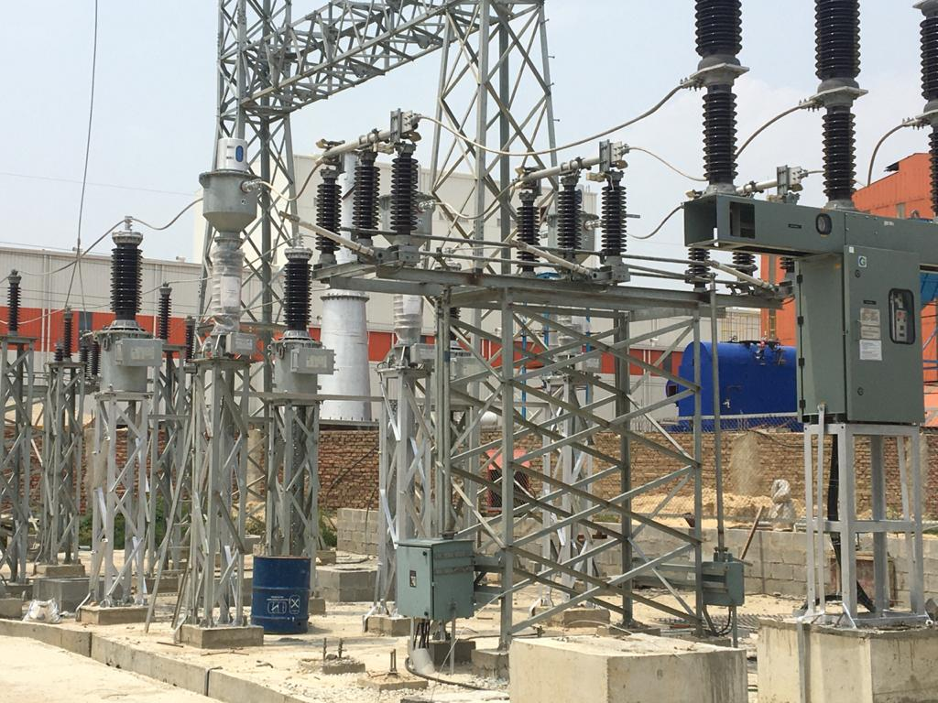

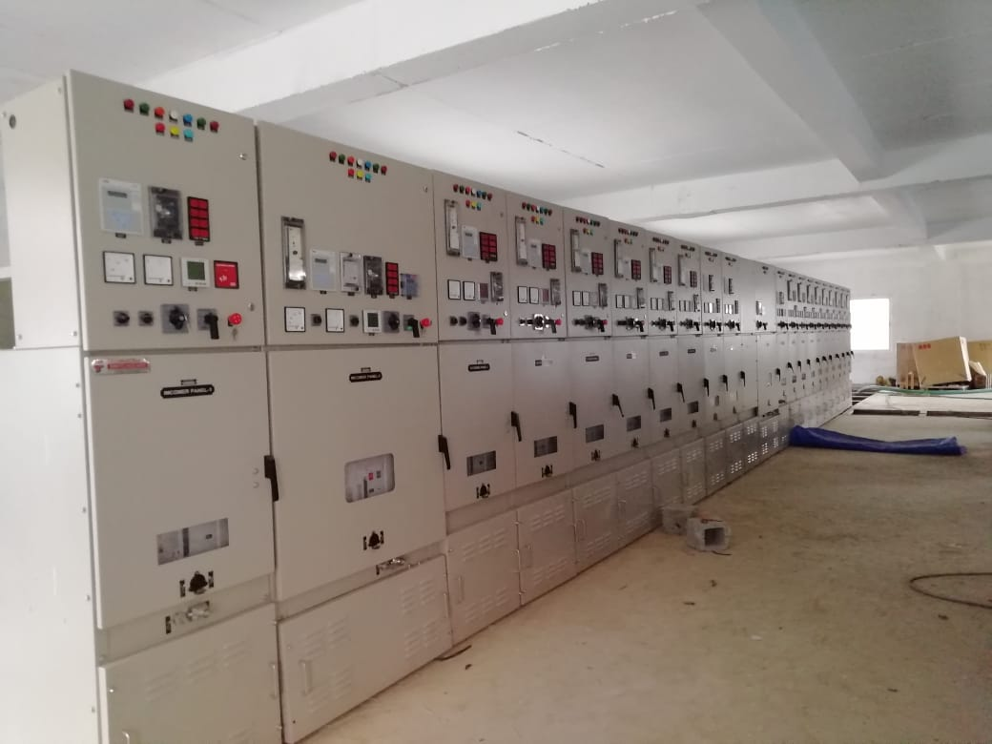
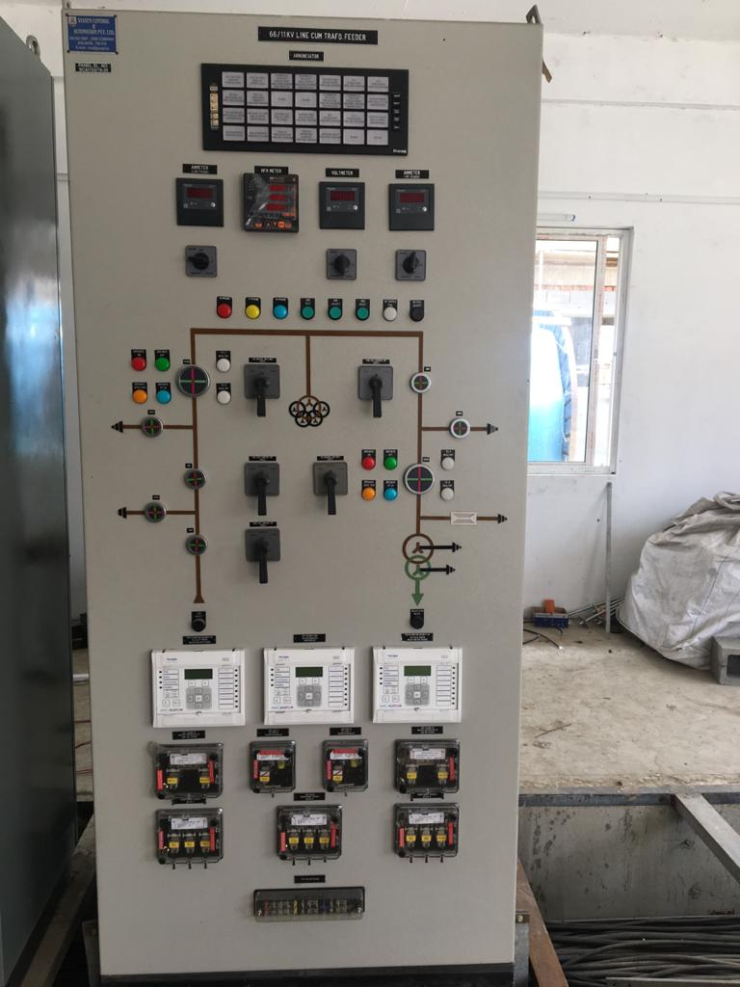
SHYAM ELECTROMECH SOLUTION

Slide 2
INTRODUCTION
Shyam Electro Mech Solution , Company in the business of providing Detailed Engineering services, Turnkey Contracts and O&M services in Electrical and Instrumentation discipline for various types of projects in the field of Steel Plant, Cable plant, Cement, Textile Plant, Paper industries as well as Commercial Complex and Hotels. The company has been in this field for carrying out extensively all types of electrification work. The company has a team of highly qualified and Skilled personnel to complete the project in desired time schedule and still maintain the highest quality work.
The Company is headed by Mr. Shashi Tripathi who is having working experience of 22 years in the field with various reputed organizations like Mitsubishi Ltd, PARI ltd, Mmi Steel Tanzania, BMW Steel Jamshedpur , Devki Steel Kenya, MMI Steel ltd Zambia. Jagdamba Steels Pvt ltd Nepal. Olak roofing Nigeria, And Lodhia Steel industries Tanzania .

Slide 3
INTRODUCTION - 1
Prior to initiating this organization. Company profile and reference list for Construction projects is enclosed for ready reference. We pleased to introduce ourselves as one of the contractor for providing comprehensive and high-quality services. Testing and commissioning of switchyards and Substations. We undertake all types of electrical works like Testing and services of Power and Distribution Transformers, HV / LV panels, Scheme Testing etc. We have expert team to carry out Testing, Commissioning & Maintenance of Various kinds of electrical equipments like MV/ LV Switchgear Panels, protective Relay circuit Breakers & other electrical equipments of different make like Alstom, ABB, L&T, Siemens, , LG, GE, Jyoti, etc.

Slide 4
PROFILE
We always emphasize on scrutinizing our customer’s need and feed it with our Technical Support. We are assuring you of our best services forever and anticipating long term valuable Business Relations. Looking forward in to prolong our journey towards the excellence with Co- operation of our valuable client like you. Thanking you and assuring you of our prompt and quality services at all times. In addition to the above Company is having an operation and maintenance contract for Steel Plant, Power Plant and & all process plants. The company has been also deputing skilled technical manpower for various Industries in India.
(SHASHI TRIPATHI)
+91 7367980692, Email: trishashi@gmail.com

Slide 5
ELECTRICAL PANEL ERECTION, & CABLE LAYING,
FOR THIS PLANT
COLD ROLLING MILL ,4 HI ,6 HI &,SKINPASS
COLOR COATING LINE .
GALVALUME LINE .
PICKLING LINE.
ARP (ACID REGENATION PLANT )
TUBE MILL .
HR CTL ,CR CTL, HR SLITTING .
WIRE AND ROD MILL .
GAS POWER PLANT 5 MW

Slide 6
OUR ACHEIVEMENTS TILL DATE
11 KV SUBSTATION INSTALLATION & COMMISSIONING IN (MMI STEEL ,TANZANIA)Including , 5 MVA Transformer
33 KV SUBSTATION INSTALLATION & COMMISSIONING IN (BMW STEEL ,JAMSHEDPUR) Including , 15 MVA Transformer
33 KV KV SUBSTATION INSTALLATION & COMMISSIONING IN (DEVKI STEEL ,KENYA ) Including , 20 MVA Transformer.
66 KV KV SUBSTATION INSTALLATION & COMMISSIONING IN (Jagdamba steel ,Nepal) Including , 31.5 MVA Transformer.
33 KV substation and 5 MW Gas power plant in Lodhia steel

Slide 7
LT PANEL INSTALLATION & CABLE LAYING
Galvalume plant Electrical panel installation and all cable laying ,( Mmi Steel ,Tanzania )
Full CRM Complex Electrical panel installation and all cable laying ,( BMW Steel Jamshedpur)
Full CRM Complex Electrical panel installation and all cable laying ,( Devki Steel Kenya.)
Tube mill plant Electrical panel installation and all cable laying ,( Mmi Steel ,Zambia )
Full CRM Complex Electrical panel installation and all cable laying ,( Jagdamba Steel Nepal)
Full CRM Complex Electrical panel installation and all cable laying ,( Lodhia Steel Tanzania)

Slide 8
SPECIALISATION
SPECIALISATION IN ALL KIND OF ELECTRICAL WORK IN ENGINEERING AND CONTRACTING WITH PROJECT JOB.
PLANT OPERATIONS AND MAINTENANCE / TROUBLE SHOOTING .
LUMPSUM TURNKEY CONTRACTS.
ANNUAL MAINTENANCE CONTRACTS FOR ELECTRICAL.
TESTING & COMMISSIONING OF ALL TYPE HV/LVPANEL AND ALL TYPES RELAY AND BREAKRES AND TRANSFORMER, SWITCHYARD UP TO 33 KV.
DEPUTING SITE ENGINEERS, CONTRUCTION ENGINEERS, SKILLED ELECTRICIAN.
Skilled Manpower Supply to various industry .

Slide 9
ENGINEERING SERVICE
Installation, Testing & Commissioning of Utility & Private 33/11 KV Substations,
Installation, Testing & Commissioning of HT/LT Panels, HT/LT Cables, Transformers, DG sets, complete low side electrical works.
SITC of Fire & Security Systems, & Plant PA Systems.
Plant Pipe Line work including Mechanical fabrication .
HVAC, , Installation, Testing and Commissioning of air-conditioning system.
Chilled water System .And Plant Fire Fighting System

Slide 10
QUALITY POLICY
We are committed to provide timely quality services for design, construction, testing and commissioning of equipments and other services to our clients. In particular, we are committed to:
Customer satisfaction.
No compromise on quality.
Continuous improvement of quality system.
Optimize quality and quality output from men and machineries. The management is committed to uphold quality policy by following means.
Action on customer complaints immediately.
Training to employees for switch gear and protection system up to 33 KV
Upgrading the tools and tackles.

Slide 11
Health, Safety & Environment Policy
It is the Policy of Shyam Electro Mech Solution to give great importance to Health and safety of its employees in design, construction, operation & Maintenance of all the equipments and facilities. It is the duty of the management to do everything possible to prevent personal injuries . It is equally duty of every employee to exercise personal responsibility and to do everything to prevent injury to him and others. Protection Of environment is of prime concern and important business objective. In Particular, we are committed to: Comply with relevant laws and regulations. Follow a systematic approach to environmental management plan in order to achieve continual performance improvement. Prevent pollution, maximize recycle and reduce waste discharges and emissions. Emphasize every employee’s responsibility in environment performance; ensure appropriate operating practices and training. Promote awareness among contractors, suppliers and customers for shared responsibility towards environment protection. Ensure licensed persons are working for important talk. Provide safety ware such as Helmet, Safety Shoes, Gloves, Glasses, Apron, Safety Belt etc. to be field staff

Slide 12
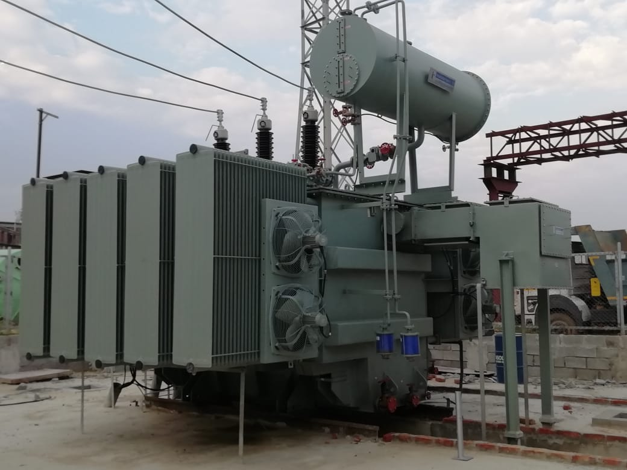
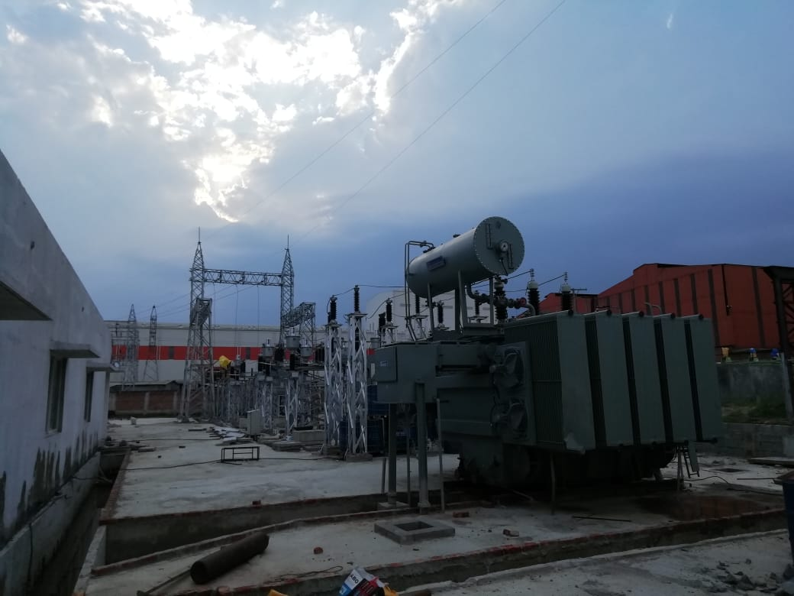
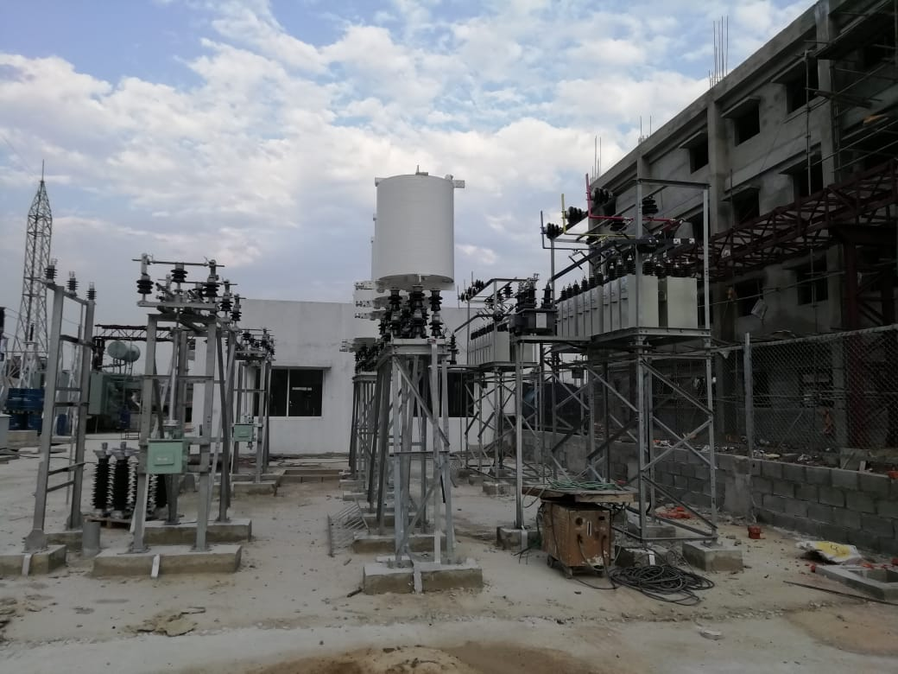
66 kV substation project Snaps

Slide 13
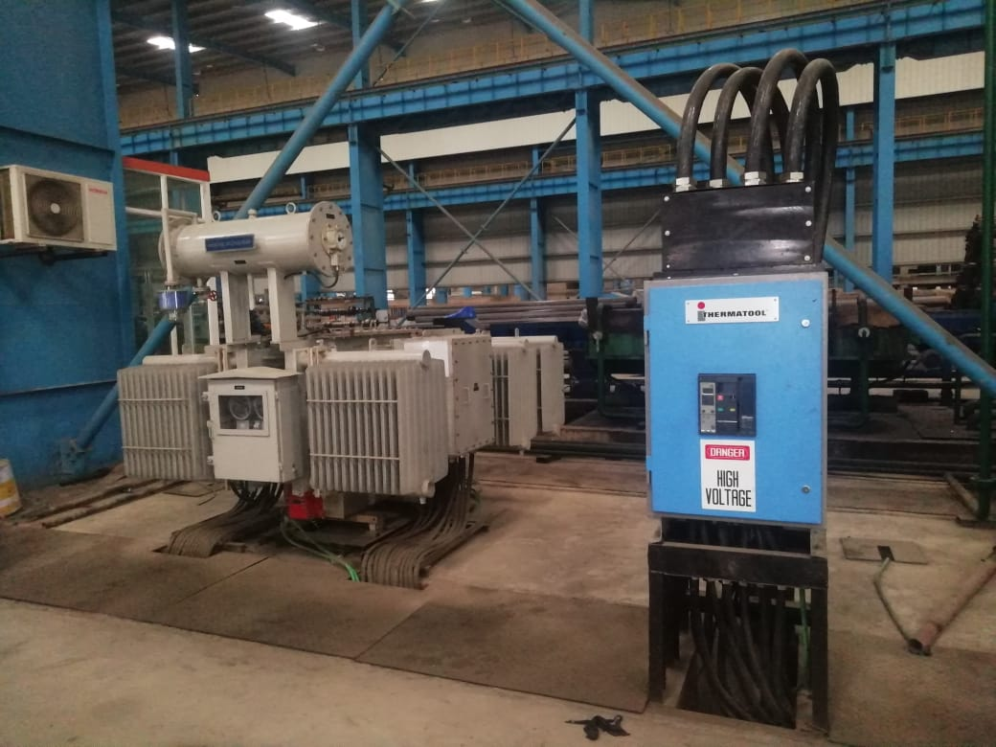
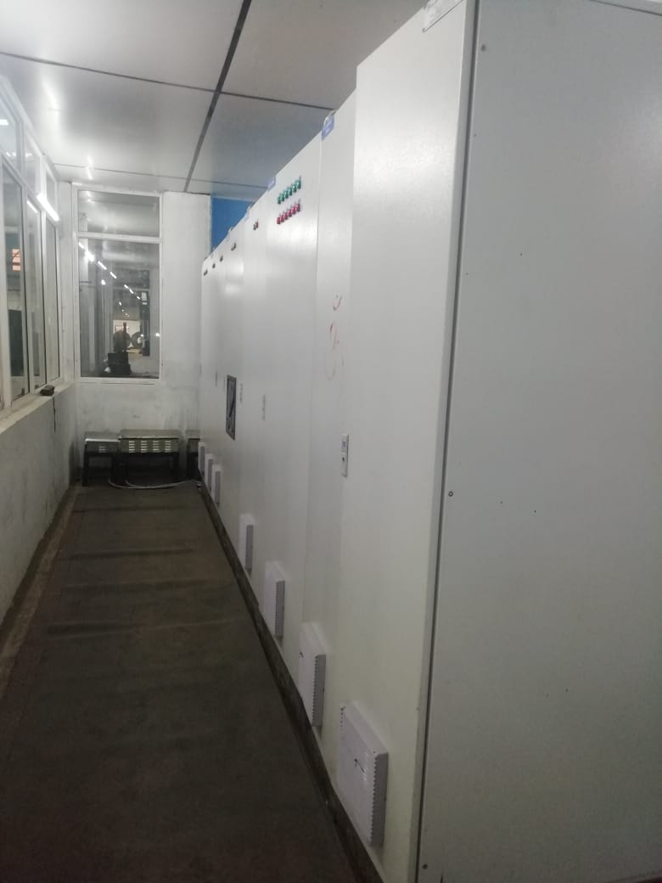
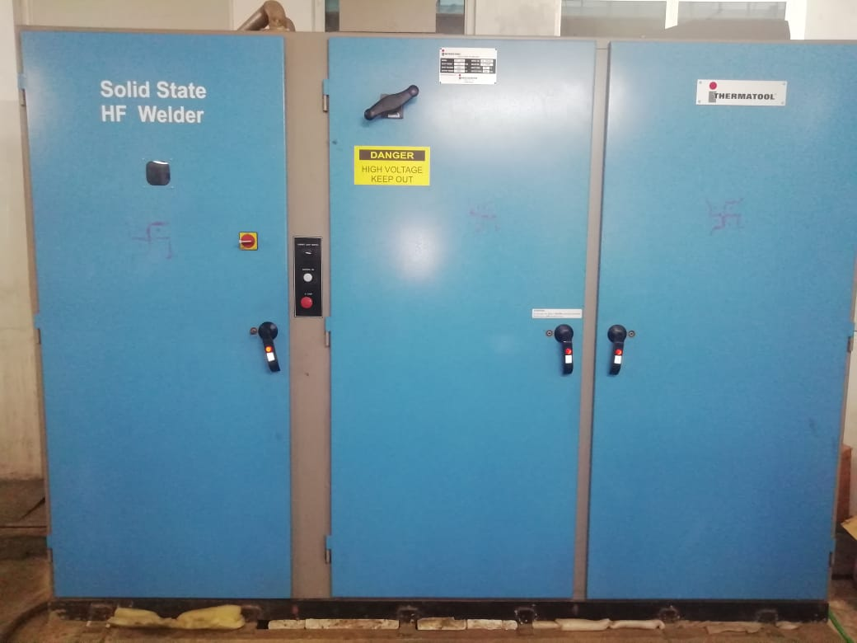
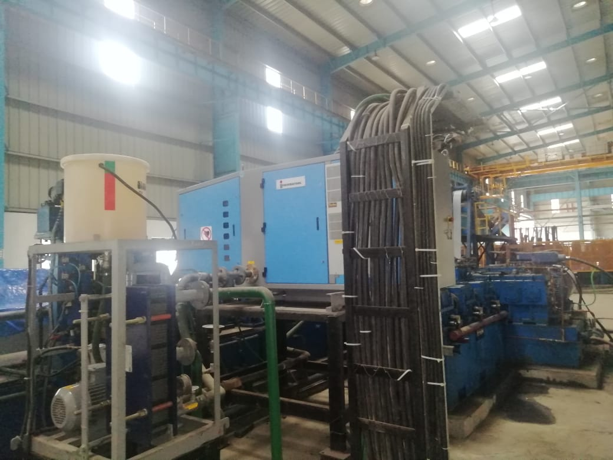
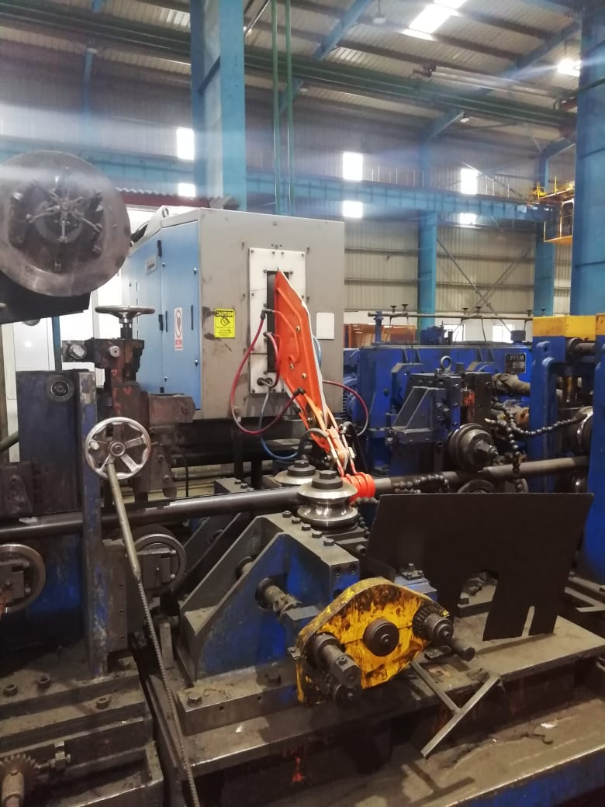
Tube Mill Project Snaps

Slide 14
WHY SHYAM ELECTRO-MECH SOLUTION
Ideal one point Control center for complete project
Highly qualified team at client's disposal
Cost optimization
Confidentiality & secrecy of Client's data
24 Years of experience in Electrical ,Automation, & Plant Maintenance, Various Industry.
Innovative engineering solutions with value-added expertise
Strategic access to Technology Licensors and Contracting companies
Flexible, Client-conscious approach
Quality-certified systems and standards
Safety and environmental considerations
Commitment to cost and time schedules

Slide 15
CONTACT US
Address: Mahadev Jharkhandi Tukda No.01
Divya Nagar Bhairopur Near Hanuman Mandir
Raneedeeh PO : Kurnraghat Distt:Gorakhpur
Utter Pradesh -273008
GSTIN: 09AHSPT7421R1Z4
MSME: UDYAM-UP-32-0126375
Email:- trishashi@gmail.com
M +91 7367980692
Whats App call +91 7367980692

Slide 16

SHYAM ELECTROMECH SOLUTION
Thank---------You

